Slide 1

Personal Health Data:
Understanding the Rapidly Evolving Use of Technology in Fitness, Health and Wellness
December 8, 2015
MotionSoft Summit Webinar Series

Slide 2

About Today’s Presenter
Jill DeGraff Thorpe
Partner
Manatt Phelps & Phillips
Washington D.C.
JThorpe@manatt.com
202.585.6656 (w)
Provides strategic advice, data security and privacy counsel and commercial transactions expertise for connected health start-ups, and for payors and healthcare providers integrating innovative health technologies into care delivery programs.
Previously, GC / VP Strategy for AFrame Digital, an early pioneer in wearable wristwatch monitors and FDA-cleared, cloud-based remote monitoring.

Slide 3

About Manatt
Nationally Ranked Law Firm
Healthcare
Advertising, Marketing & Media
Entertainment
Strategy Consulting
Manatt Health Solutions
Manatt Digital Media

Slide 4
Building A Model For Monetizing Personal Health Data
C2C Social networks share their favorite playlists
B2C: Integrate music streaming platform with mobile health apps or wearables for social networks to share playlists for exercise
B2C: Let social networks to create health challenges to unlock their favorite playlists
B2B: Let coaches, instructors or celebrities create health challenges to unlock their playlists
B2B: Create highly configurable or branded platforms for clubs to create comprehensive, entertainment-inspired health challenge programs
Use consumer entertainment and social media to inspire activity
Use activity data – even the number of unlocked playlists – as interim process measures to gauge progress towards member health goals
Use biometrics as key performance indicators of value
Get paid by the healthcare system for delivering value

Slide 5
Business Thesis
Unlike physicians, certified club staff can devise and execute nonclinical, consumer-directed programming that makes personal health data actionable
Health clubs can leverage their expertise in consumer marketing
When defining your mHealth strategy–
  Simplify selection from overwhelming array of incomplete mHealth apps
  Simplify data collection
  Integrate lifestyle, diet and exercise
  Maximize connectivity, communication, functionality, social media
  Unify user experience with your club’s physical and virtual environments
  Deliver high production value
  Quantify impact of modest improvements in prevention and reduced treatment
  Target members with 1+ chronic conditions
  Negotiate contracts with healthcare providers, employers and payors that tie payments to measurable achievement of objective health indicators (BMI, weight, bp, A1c)
  Deliver results at less cost than clinical programs
Be the partner where people play and near where they live and work.out You

Slide 6
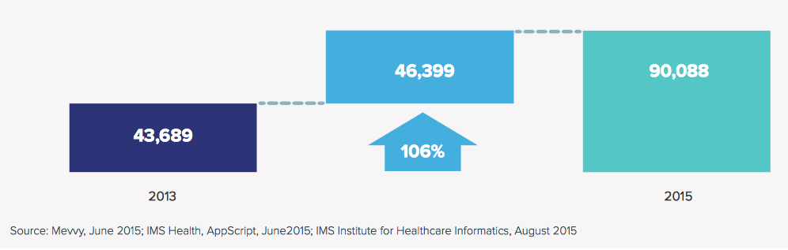
Personal Health Data Is Proliferating, But It’s Fragmented
76 million smartwatches and activity trackers will ship in YE2015
165,000+ mHealth apps on Apple App Store and Google Play
mHealth apps on the Apple App Store more than doubled from 2013 to 2015
Source: “Patient Adoption of mHealth: Use, Evidence and Remaining Barriers to Mainstream Acceptance”, IMS Institute for Healthcare Informatics, Septmber 2015

Slide 7
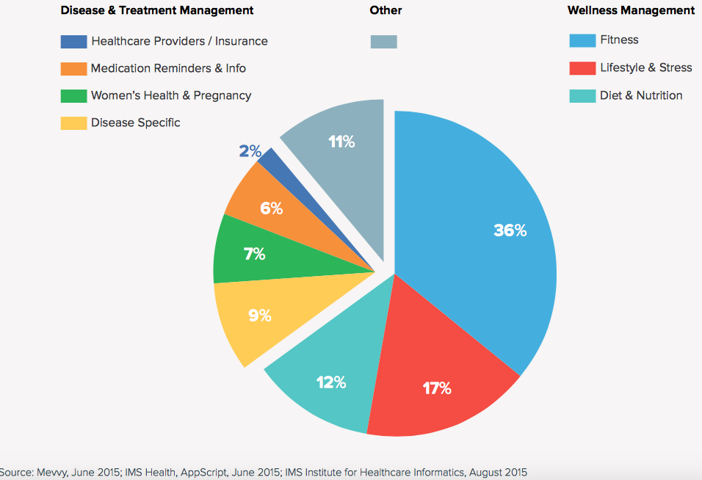
65% of mHealth Apps Relate To Fitness, Lifestyle and Diet
Most mHealth apps have limited functionality (education, mostly)
10% connect with a device or sensor
65% connect to social media
Only 2% connect with healthcare providers

Slide 8
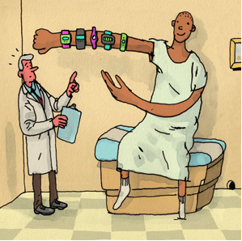
“Your Doctor Doesn’t Want to Hear About Your Tracking Data”
After comparing data reported by consumer wearables to relevant clinical gold standards in multiple studies, researchers at UCSF Center for Digital Health Innovation found very few that were as reliable as a medical-grade device.
“Clinicians can’t do a lot with the number of steps you’ve taken in a day”.
Source: Rosenblum, MIT Technology Review, November 24, 2015

Slide 9
But Doctors Are Happy If Others Achieve Results For Them
Omada (diabetes)
  16-week, clinically validated weight loss reduction program for individuals at risk of developing Type 2 diabetes. Clients include Humana, Providence Health
  Program includes wireless weight scale, mobile app and dedicated nonclinical coach
Kurbo Health (obesity) –
  Clinically validated program for children, youth and families to overcome pediatric obesity
  Recently announced partnership with Humana
Chrono Therapeutics (tobacco cessation)
  Pharma company combines wearable patch with companion mobile app and dedicated coaching
Lantern Health (mental wellness)
  Mobile app-enabled coaching helps clients navigate life stressors, supported by one-on-one coaching via text messaging. Includes assessment, goal-setting, personalized exercises, etc.
B2B mobile app platforms for health clubs could make programs like these available to members, using gym’s appropriately licensed staff.as coaches.

Slide 10
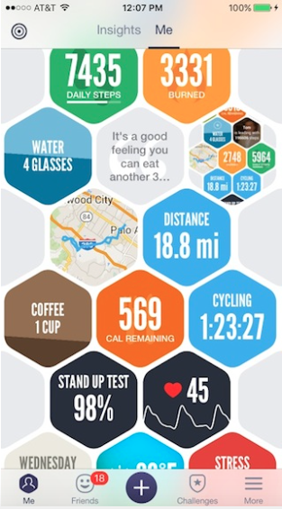
Innovators Remain Hopeful That User-Generated Health Data Will Be Clinically Relevant
Under NIH-sponsored study, Azumio contributed de-identified anonymized data of 5 million users to Stanford computer science researchers
Types of Data
Heart Rate
Sleep
Activity
Walking
Running
Cycling
Working Out
Diet
Calories
Food Categories
Photographs of Food
Broad Latitude for Research Inquiry
Hypothesis generation, including:
Gait analysis
Mobility
Combined with
Geographic Data
Social Media Usage
Source: MobiHealthNews, November 17, 2015

Slide 11
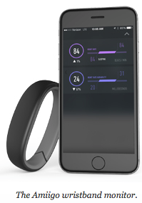
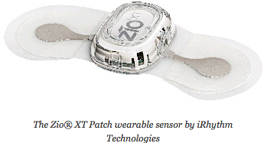
Even Industry Believes in Promise of Consumer Wearables:
Aetna and Johnson & Johnson Support Novel Clinical Trial
Study for improved detection of atrial fibrillation
Is continuous monitoring with medical-grade Zio biopatch better at detection than usual standard of care (regular office visits)?
Can monitoring of heart rate and rhythm characteristics using an Amiigo wrist monitor also improve detection of atrial fibrillation?
Source: Scripps Translational Science Institute

Slide 12
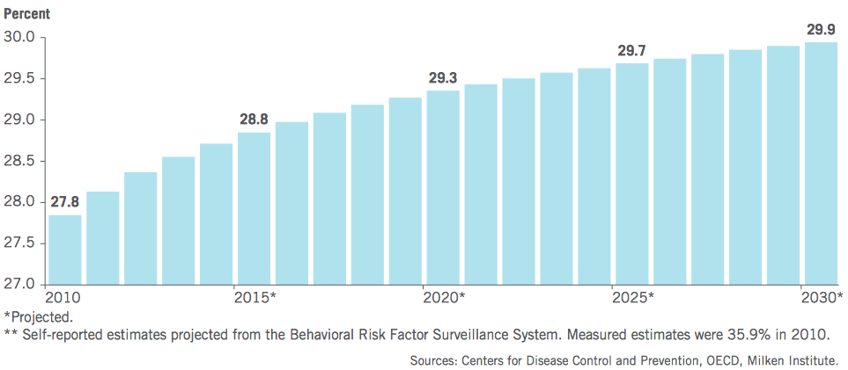
Lifestyle-Induced Disease Imposes Large Economic Burdens
109 million Americans have 1+ chronic disease
$1.3 trillion Economic burden in treatment and lost productivity
$220 billion Potential savings by 2023 from modest improvements in prevention and treatment
Key Recommendations
Healthcare system should create incentives for prevention
The U.S. should renew its commitment to healthy body weight
Adult Obesity Rates**
Source: Milken Institute: Chronic Disease and Wellness in America (2007, 2014)

Slide 13
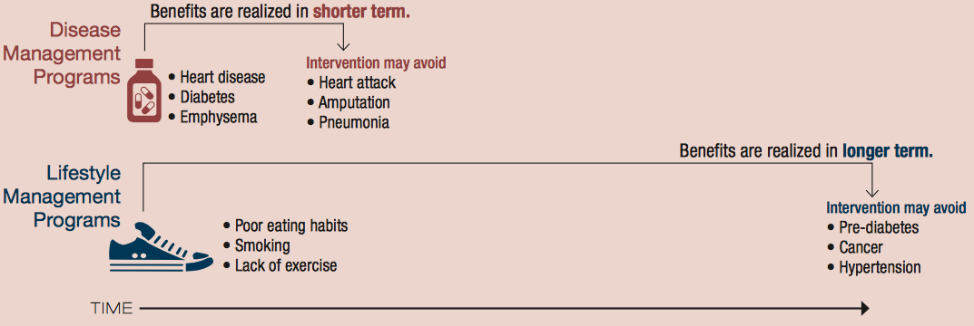
For Health Clubs, Partner With Health Care To Deliver Objectively Measured Health Benefits
($0.52) Loss for each dollar spent in lifestyle management programs
$3.78 Savings for each dollar spent in disease management programs
$6 bil Size of corporate wellness industry (compared to $1.3T economic burden)
Avoid Comparisons with Traditional Corporate Wellness Programs
Source: Rand Wellness Programs Study (2014)

Slide 14


Slide 15
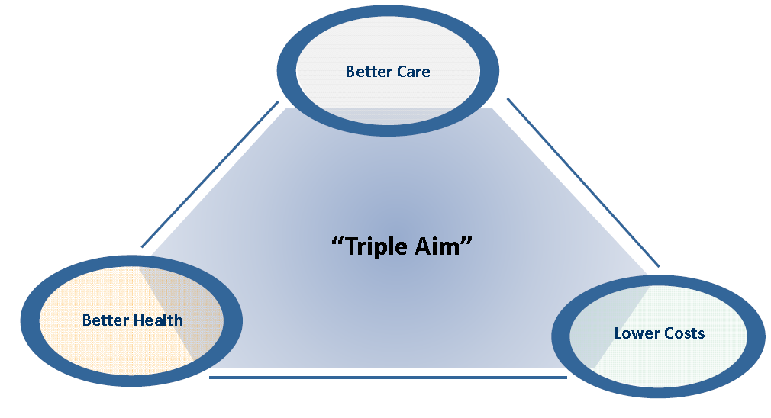
What Is Value?

Slide 16
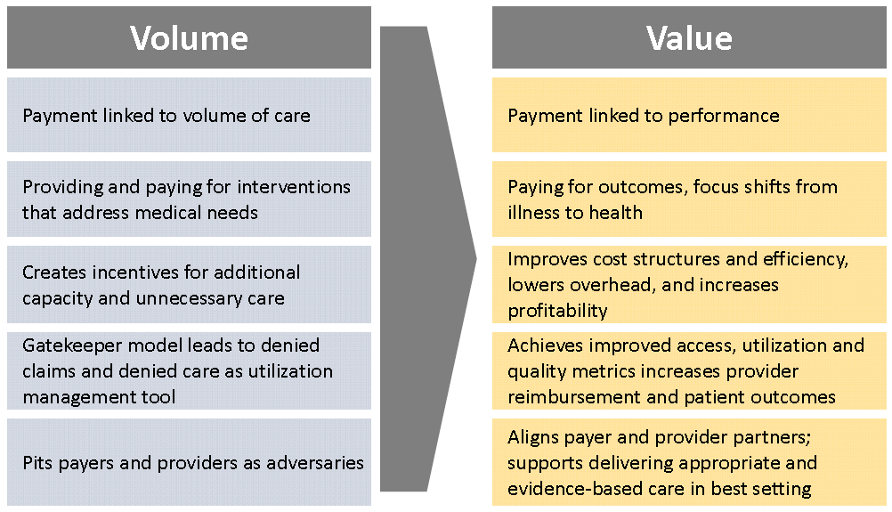
Changing Focus from Volume to Value

Slide 17
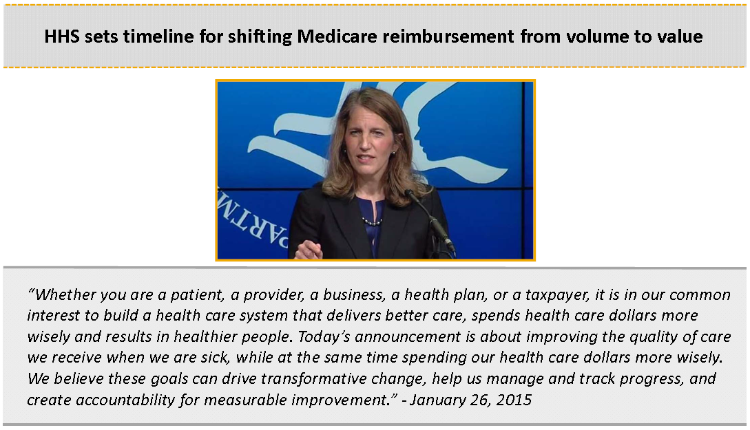
Obama Administration Sets Agenda for Value-Based Payment

Slide 18


Slide 19
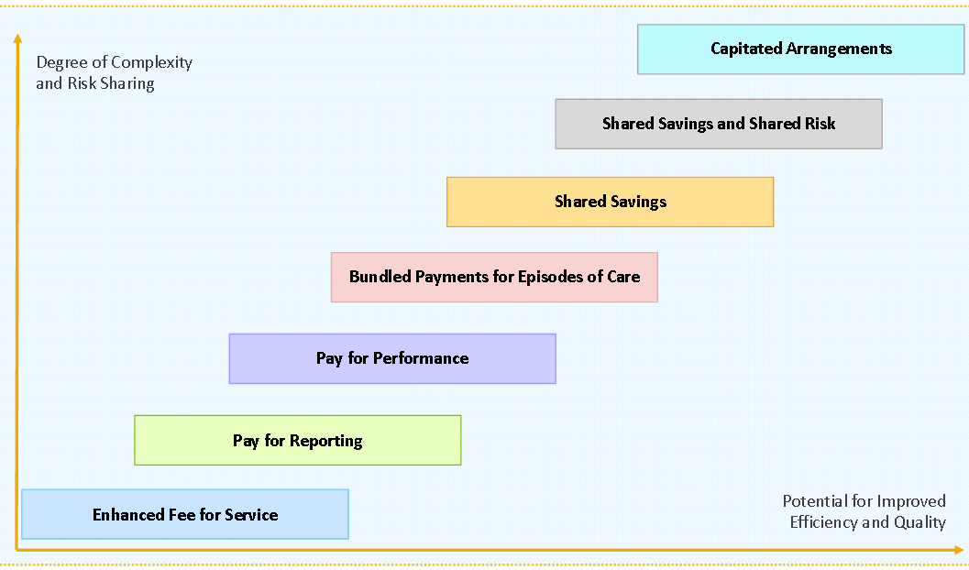
Continuum of Value-Based Models

Slide 20
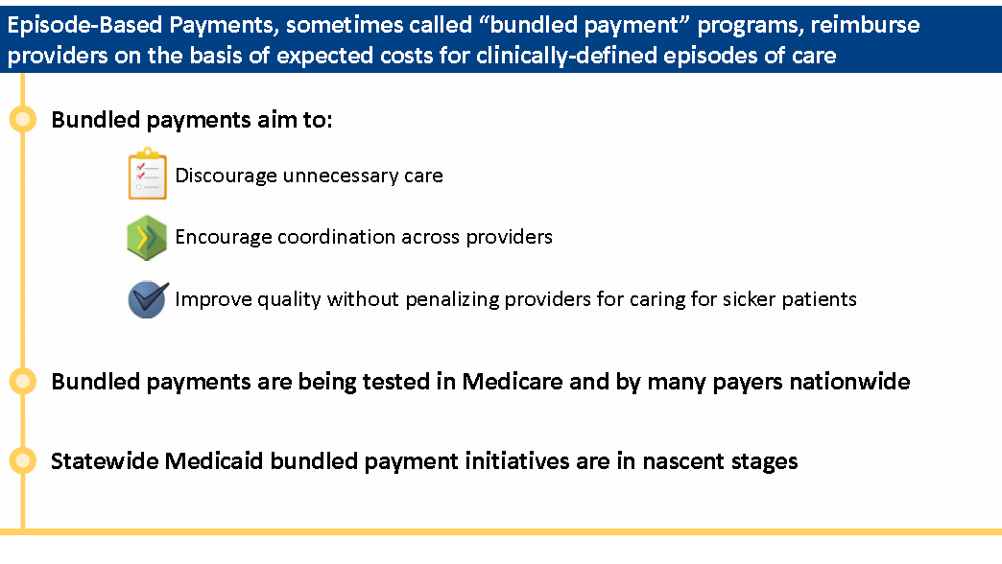
Episode-Based (“Bundled”) Payments

Slide 21
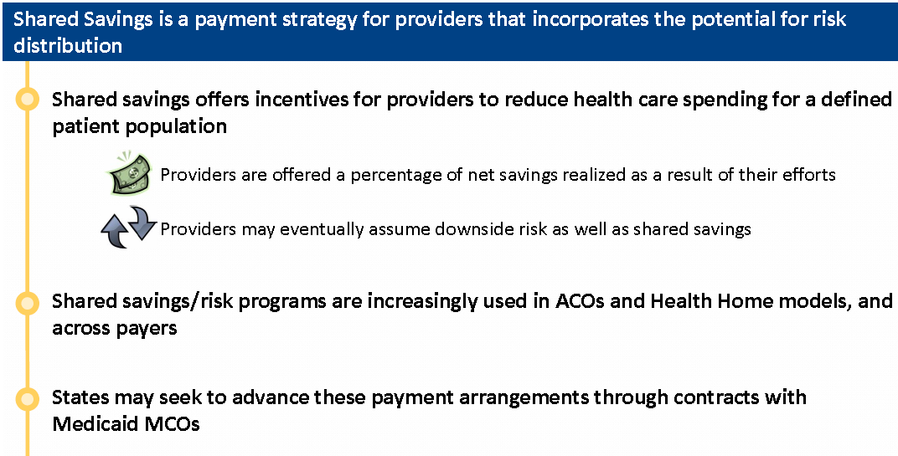
Shared Savings/Shared Risk Arrangement

Slide 22
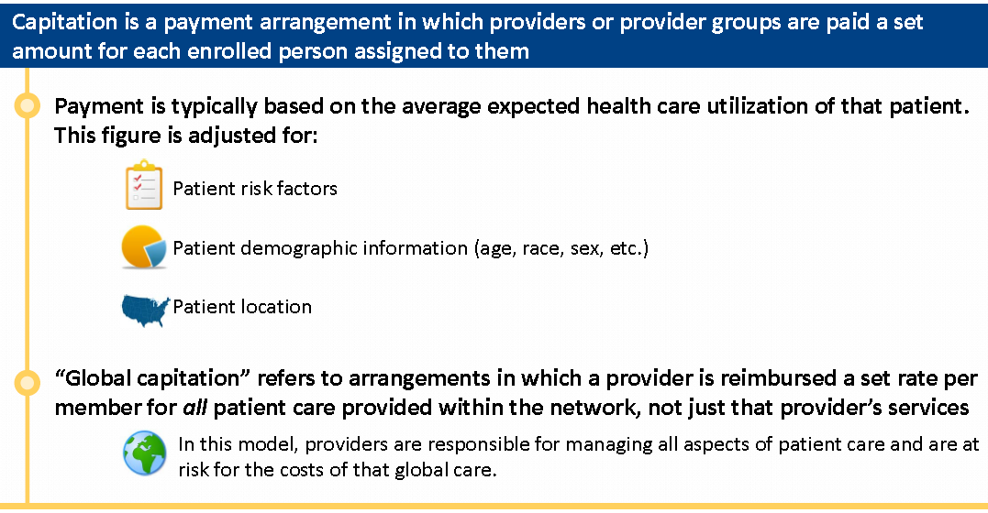
Capitated Payments to Providers

Slide 23
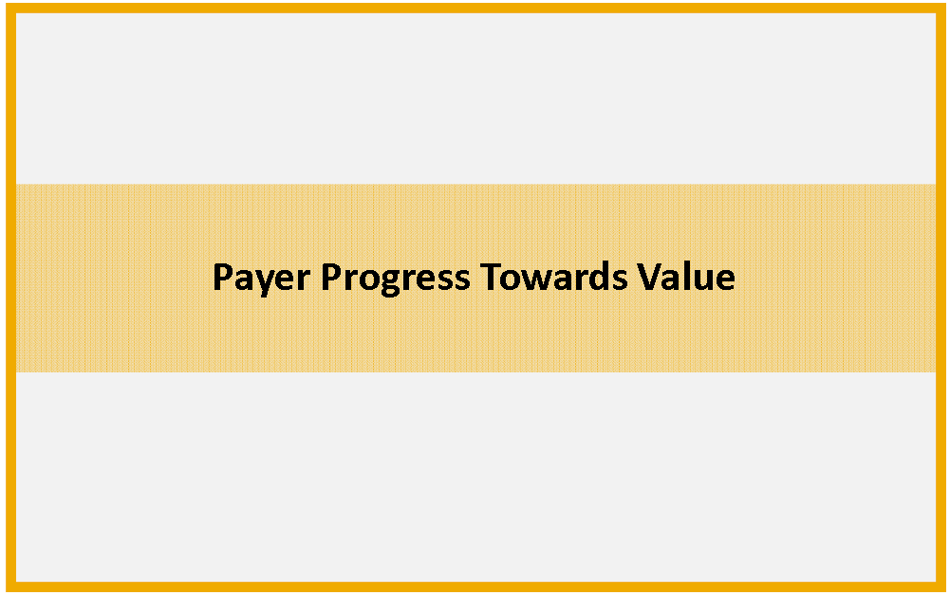

Slide 24
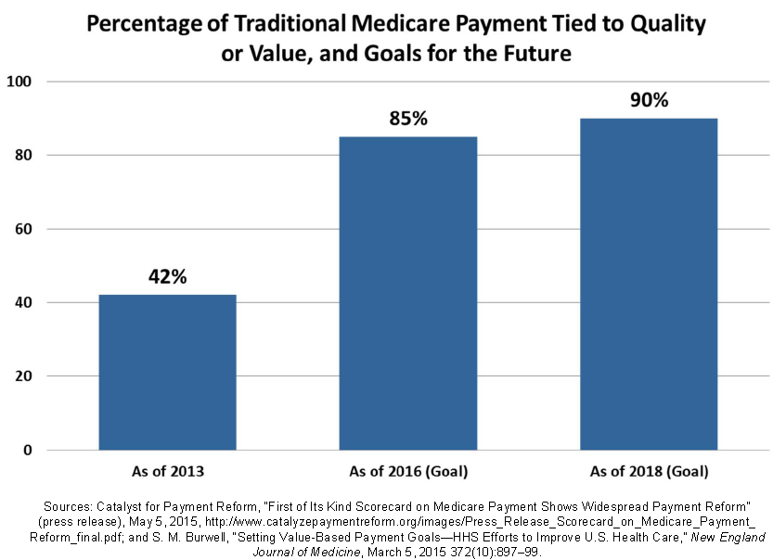
Medicare Timeline/Goals for Reform

Slide 25
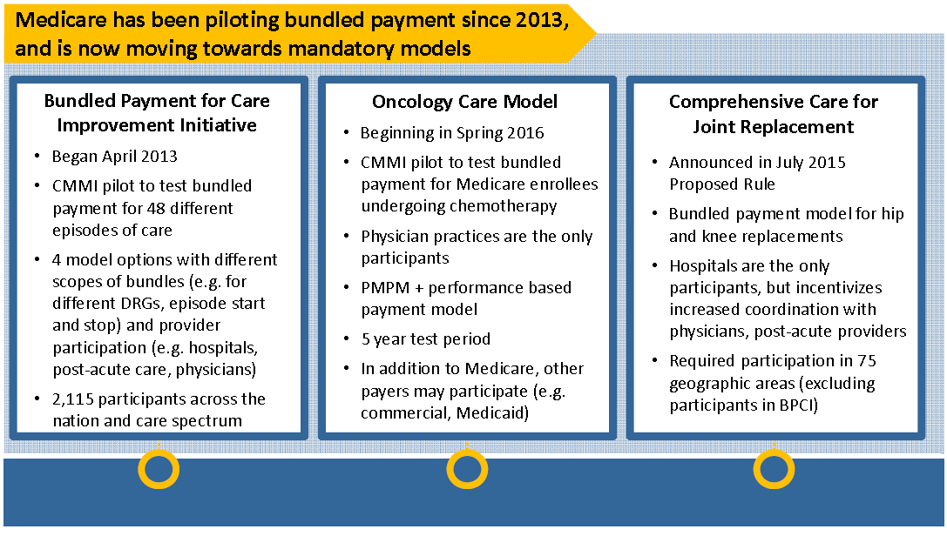
Medicare Bundled Payments

Slide 26
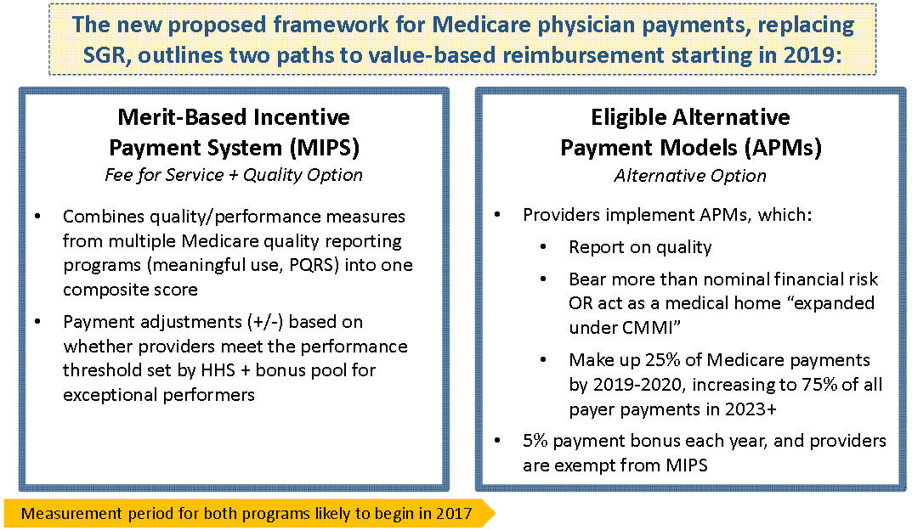
Medicare and CHIP Reauthorization Act of 2015 (MACRA)

Slide 27
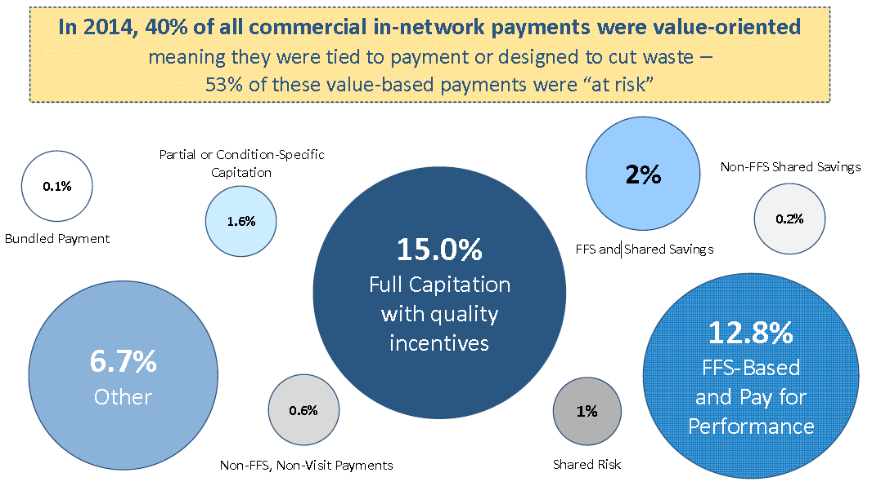
Progress of Commercial Payors Towards Value

Slide 28
Health Care’s Shift To Value Is Real, And Accelerating
As healthcare providers assume more financial risk for the health of a given population, they are open to strategies that improve prevention, reduce medical spend and help them acquire more plan members
Financial risk makes providers more flexible about using nonclinical services to achieve desirable health goals
Yet, value must be tied to objective measures of performance, like biometric indicators against baselines
KPIs spare providers from reviewing nonclinical data

Slide 29
The Benefits of Organization Firewalls for HIPAA Entities
For HIPAA covered entities, a firewall that prevents them from accessing user-generated health data –
shifts burden to health club to make that data actionable
Reduces burden for them to figure out its clinical relevance
Alleviates responsibilities for securing the data and making it accessible
Eliminates risk of a plaintiff alleging that a health care provider committed an injury by not evaluating user-generated health data in the provider’s data warehouse

Slide 30
Regulatory Rules Change If a Club Shares Data with Providers
ePHI
Consumer-Generated
Health Data
Personally Identifiable Information
ONC – MU3
Privacy
Data Security
Patient Access
HHS/OCR – HIPAA
Privacy
Data Security
Permissible Use Authorization
FTC
Fair Business Practices
Compliance with TCPA, COPPA and State Laws
Notes:
Personally Identifiable Information (PII)
Any data that alone, or when combined with other data sets, can identify you. It doesn’t have to relate to health. Subject to FTC’s authority to enforce fair business practices
Consumer Generated Health Data (CGD)
Subset of PII. Any data generated by consumers when they use a consumer wearable (and other types of wireless or mobile device) outside the clinical setting if it is relevant to their health or well-being. Usually, wearables contain biometric sensors for passive data collection.
Protected Health Information (PHI or ePHI)
Under HIPAA, PHI or ePHI refers to individually identifiable health information
HIPAA applies to “Covered Entities” and their business associates
A sidenote: not all wearables with biometric sensors require FDA clearance as a medical device, but when they do, FDA jurisdiction also applies.
In Oct 2014, the FDA issued guidance about the activities they expect of medical device makers to assess and protect against the risk of cyberattacks.
[Next, review the laws and regulations for fair business practices]
http://www.fda.gov/downloads/medicaldevices/deviceregulationandguidance/guidancedocuments/ucm356190.pdf
ities” (healthcare providers, payors and their business associates)

Slide 31
FTC Requires Health Clubs To Protect Personal Health Data
Sample Security Program Requirements
Establish and maintain a comprehensive information security program with administrative technical and physical safeguards
Designate an employee(s) to coordinate and be accountable for program
Identify threats to the security, confidentiality and integrity of personal information that could result from unauthorized disclosure, misuse, loss, alteration, destruction or other compromise.
Assess the sufficiency of administrative, physical and technical safeguards, such as
  Employee training and management
  Information systems, including network and software design, information processing, storage, transmission and disposal
  Prevention, detection and response to attacks, intrusions or other system failures
Design and implement reasonable safeguards to control risks identified through risk assessment, and regular testing or monitoring of the effectiveness of the safeguards’ key controls, systems, procedures

Slide 32
FTC Requires Health Clubs To Protect Personal Health Data
Sample Security Program Requirements (continued)
Develop and use reasonable steps to select and retain service providers capable of appropriately safeguarding personal information of members, and contractually bind these providers to uphold the safeguards
Evaluate and adjust information security program in light of testing and monitoring, material changes to operations or business arrangements
Obtain initial and periodic assessments and reports from a qualified, objective, independent third-party professional
  Certified Information System Security Professional (CISSP) or Certified Information Systems Auditor (CISA)
  Global Information Assurance Certification (GIAC) from theSysAdmin, Audit, Network, Security (SANS) Institute
  Other qualified organizations approved by FTC.

Slide 33
Consequences for Health Clubs of HIPAA Compliance
Subject to more prescribed privacy, security, breach notification and enforcement rules
Directly liable for violations as a “Business Associates”, w/ or w/o contract
  Civil money penalties
Responsible for fulfilling HIPAA individual rights
  right to request a restriction on use;
  right to request access and copy of PHI;
  right to receive an accounting of disclosures
Use of PHI for marketing sharply curtailed
Sale of PHI prohibited without express written authorization

Slide 34
Advice: Consult with Counsel
To review privacy policies, terms of use and data security of mobile apps and wearables incorporated into club programming
Before exchanging any personal health data with a healthcare provider, including biometric values to track performance,
To negotiate performance-based contracts with health plans or health care networks.
To review member consent policies
To develop privacy and data security policies and procedures

Slide 35
Thank You
Los Angeles, Irvine, San Francisco, Palo Alto, Sacramento, New York City, Albany and Washington DC
www.Manatt.com

