Slide 1
51 Digital Marketing Recommendations Organic Search, Site Optimization, Email Marketing and Blogging
Todd Tweedy
Digital Strategy Professional Services
March 11, 2015 – IHRSA 2015

Slide 2
Getting started
Traffic Readiness (Organic Search)
Conversion Assessment (Site Conversions)
Prospect Engagement (Email Marketing)
Injecting SEO into your club (Blog)
Get them. Keep them. Know them™.

Slide 3
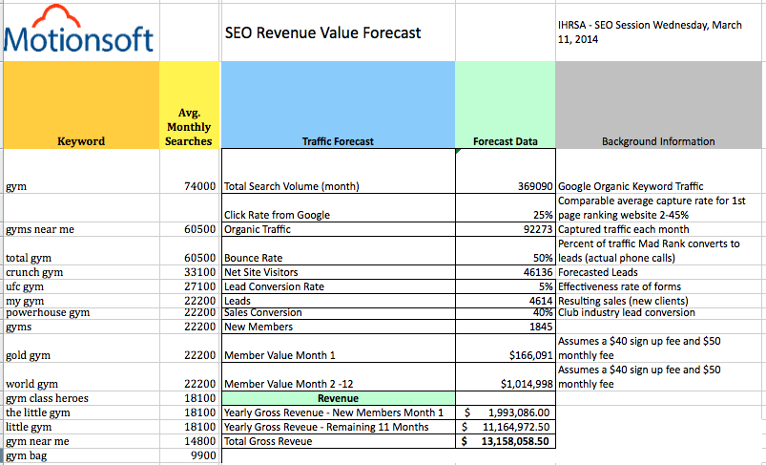
fRee SEO Value forecaster
Get them. Keep them. Know them™.

Slide 4
Traffic Readiness
Get them. Keep them. Know them™.

Slide 5
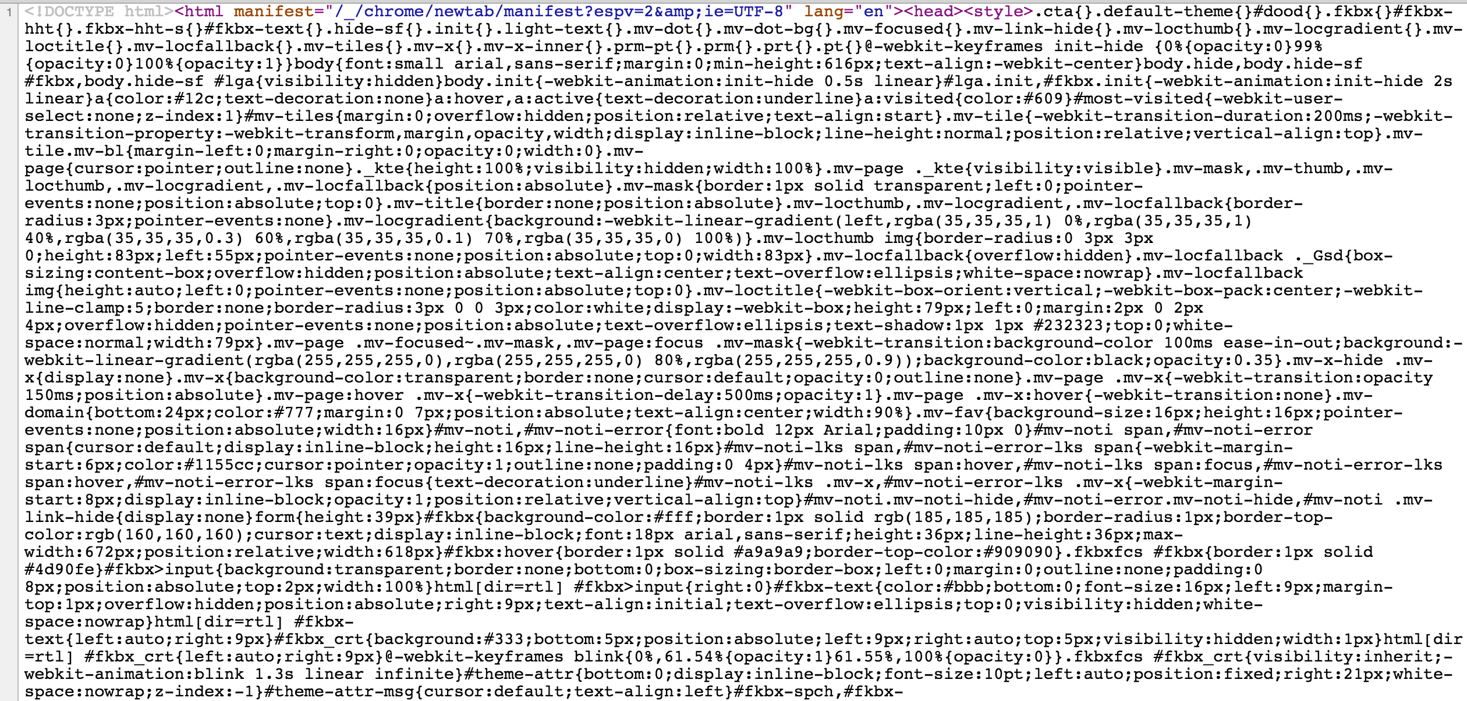
Look at the code first
Get them. Keep them. Know them™.

Slide 6
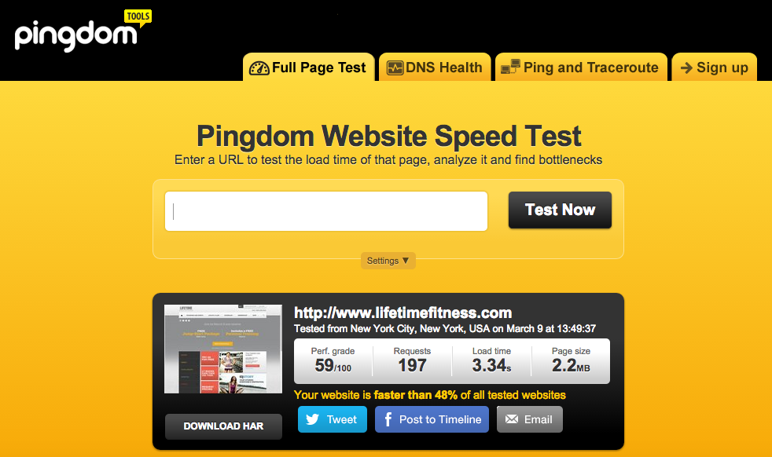
Uncover technical SEO ISSUES
HIDDEN URL
Get them. Keep them. Know them™.

Slide 7
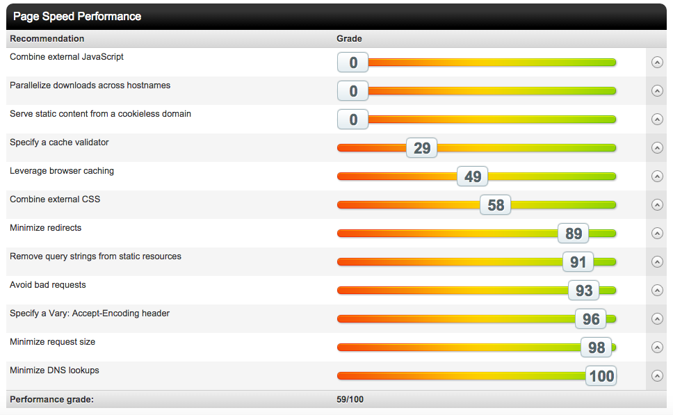
Page speed performance is critical
Get them. Keep them. Know them™.

Slide 8
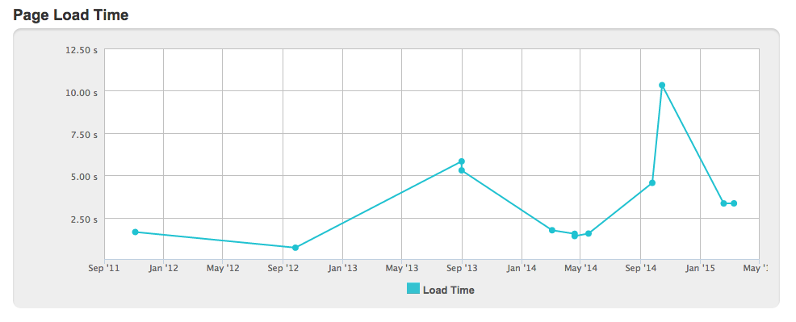
Getting started
Every site release needs to be optimized
New site launches
Get them. Keep them. Know them™.

Slide 9
Does your HTML + CSS VALIDATE?
Get them. Keep them. Know them™.

Slide 10
Getting started
Now Assess content & Context
Get them. Keep them. Know them™.

Slide 11
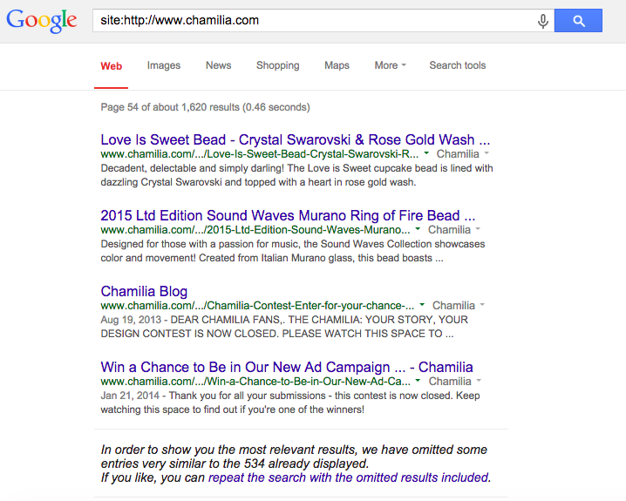
How much of Your content is duplicated?
1,620 pages indexed
66.7% of
Content Duplication
534 unique pages
Get them. Keep them. Know them™.

Slide 12
Follow Google guidelines
Robots.txt guideline
Site map /navigation page for visitors
Text / image link guidelines
XML site map for search engines
Titles and alt text guidelines
Page Speed guidelines
Amount of links per page
Dynamic link guideline
If modified since guideline
Paid links guideline
File blocking guideline
Block resources guideline
Get them. Keep them. Know them™.

Slide 13
SEO Best Practices
Clear hierarchy
Clear category hierarchy
Clear header hierarchy
Mobile SEO
User experience
Performance
No blocked CSS/JS
No redirects
Titles
Description
Image compression
Minify HTML, CSS and JS
Rich snippet Validation - https://developers.google.com/structured-data/testing-tool/
Crawl simulator
Page similarity
Get them. Keep them. Know them™.

Slide 14
Traffic readiness Quick launch
Top Six List
How is Google crawling your site?
Page speed issues?
HTML and CSS validates?
Image compression and minify HTML, CSS, JS
Page titles, descriptions, other meta data.
Use of headers and information hierarchy.
Get them. Keep them. Know them™.

Slide 15
Remember to back out bounce rates
Get them. Keep them. Know them™.

Slide 16
Where to get Keyword ideas?
Get them. Keep them. Know them™.

Slide 17
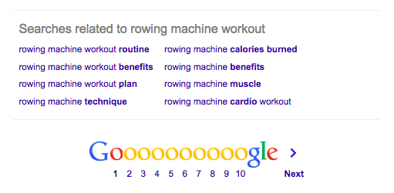
ON google – bottom of search page
Get them. Keep them. Know them™.

Slide 18
Conversion Assessment
Get them. Keep them. Know them™.

Slide 19
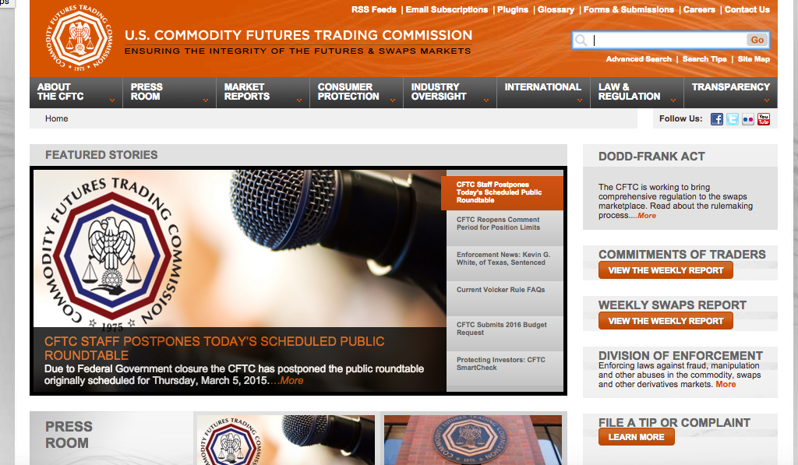
What do you optimize first?
Get them. Keep them. Know them™.

Slide 20
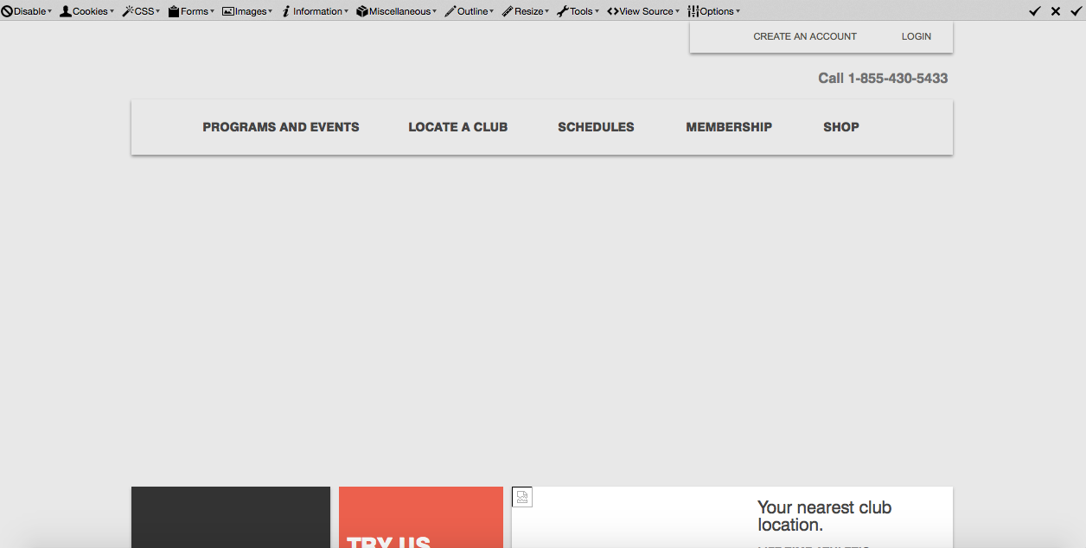
Turn off images to mirror google crawl
Get them. Keep them. Know them™.

Slide 21
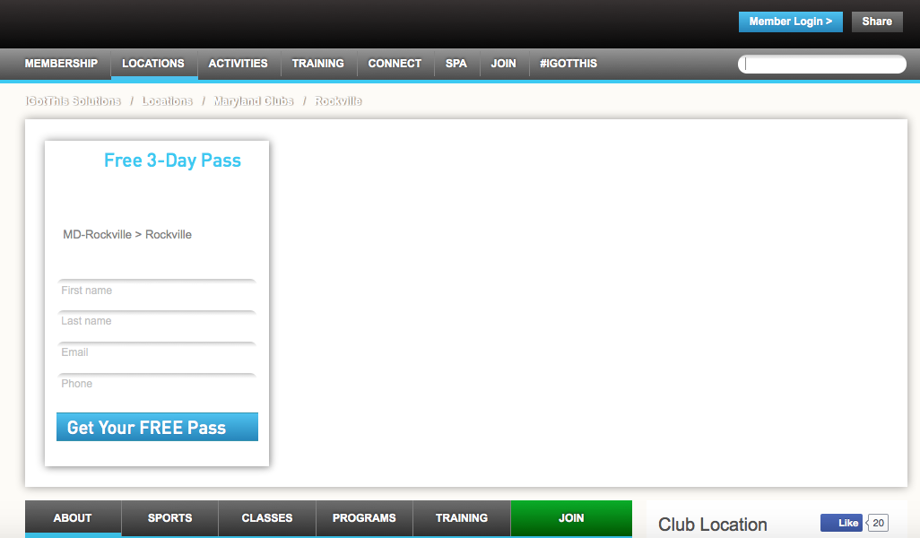
Don’t distract prospects from signing up
Get them. Keep them. Know them™.

Slide 22
Prospect Engagement
Get them. Keep them. Know them™.

Slide 23
When to communicate
Top Six List
Membership inquiries
Club tours and open house events
Free passes
Acknowledgement
Count down (# remaining)
Expiring soon
Ready to get started
New member sign up
Milestones – sessions per period
Come back
Tailored email messaging based on membership type, visit frequency including first visit, activity type (group fitness or PT) POS, spa and or café by last purchase and next best recommendation
Get them. Keep them. Know them™.

Slide 24
What does your email frequency look like?
Build a tactical marketing model.
Leverage location affinity to drive open rates
Critical to lead conversion is creating waves of treatments to trigger desired behavior.
Don’t forget non-responders.
Outbound calls can make the difference and force site visitors to enter a valid phone number.
Integrate communication model across club whether it’s a special greeting or just welcome back.
Get them. Keep them. Know them™.

Slide 25
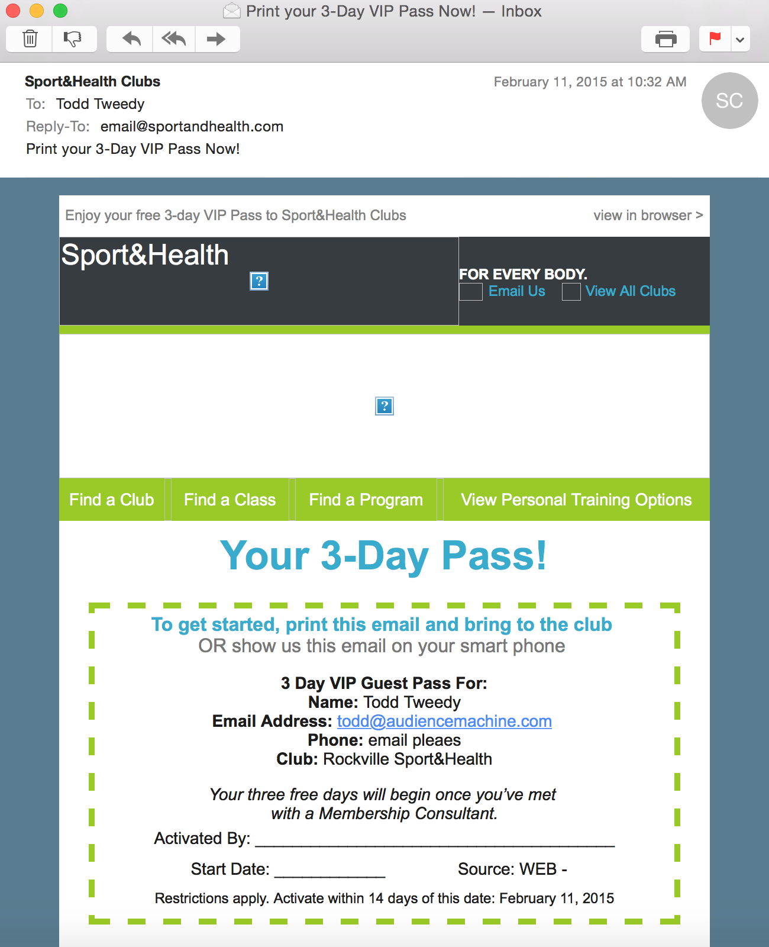
What do you test?
Pretty images push action elements down be careful how you use them.
Offer positioning is always prominent.
Is your navigation bar? Do you even need it?
Use urgency to drive behavior.
Remember address information and or directions.
Get them. Keep them. Know them™.

Slide 26
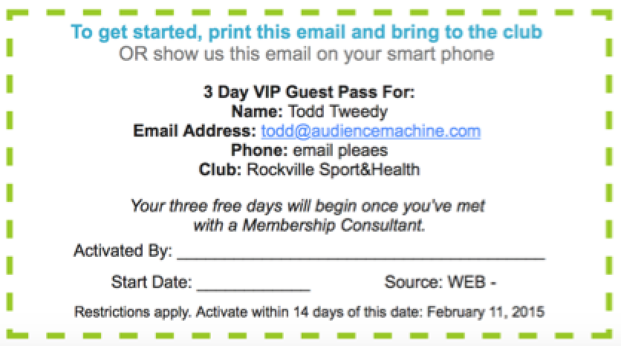
Control vs. test
Your 3-Day VIP Guest Pass
Expires in 7 days. Restrictions apply.
Need directions – 1234 Main St. Your City Name

Slide 27
Injecting SEO
into Your Club
Get them. Keep them. Know them™.

Slide 28
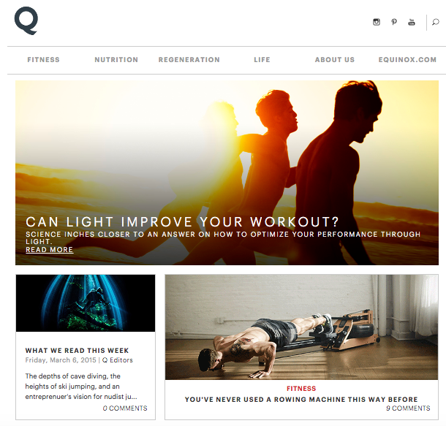
Start with your blog
Get them. Keep them. Know them™.

Slide 29
Blog Post Writing
Conduct simple keyword phrase research using results from Google Keyword Recommendations.
If needed, user the phrase recommendations to build out an article table of contents to help guide writing your piece.
Establish a process for authoring search elements after the article has been drafted:
Article title between 57 to 63 characters.
Descriptions should be between 157 and 163 characters.
Make the page title the same as the article title
No need to add brand name at the end of titles
Remember clear hierarchy? Use keyword recommendations in header tags H1, H2, H3, H4 these sections become the sub-category content blocks.
When is all this going to happen? Build in SEO efforts after your QA review process.
Get them. Keep them. Know them™.

Slide 30
Wrapping it all up
Identify code issues ASAP
Gap assessment of information organization
Plug in Google Analytics and Webmaster Tools
Bench site and email performance
Begin keyword research
Keyword assessment and page assignments
Website copy upgrades
Email marketing copy upgrades
Run another benchmark
Launch A/B split testing – site and email
Ongoing site optimization testing
Get them. Keep them. Know them™.

Slide 31
Tool list
Pingdom – http://tools.pingdom.com - site speed and performance issue identification
W3.org – http://www.w3.org - HTML and CSS validation
Spider Simulator – Web Developer 1.2.5
Firefox - https://addons.mozilla.org/en-US/firefox/addon/web-developer/
Chrome - https://chrome.google.com/webstore/detail/web-developer/bfbameneiokkgbdmiekhjnmfkcnldhhm
Keyword Research – http://www.wordtracker.com
Get them. Keep them. Know them™.

Slide 32
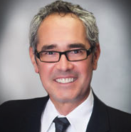
Schedule your free assessment
Todd Tweedy
Digital Strategy Professional Services
Motionsoft
301.255.6400
434.996-6370 - Cell
ttweedy@motionsoft.net
http://www.motionsoft.net
LinkedIn
https://www.linkedin.com/in/toddtweedy
Get them. Keep them. Know them™.

