Slide 1
Measuring Attrition is stopping the industry improving Retention
Dr Paul Bedford

Slide 3
“Membership attrition is measured on an annual basis. Since memberships are added and dropped each month, the attrition formula is best calculated using the average opening monthly membership for a rolling twelve-month period.
Traditional Method

Slide 4
Paul’s Health club
Start 1000 Members Jan 1st
Finish 1000 Members Dec 31st
Jan | Feb | Mar | Apr | May | Jun | Jul | Aug | Sep | Oct | Nov | Dec
+100 | +100 | +100 | +100 | +100 | +100 | +100 | +100 | +100 | +100 | +100 | +100
-100 | -100 | -100 | -100 | -100 | -100 | -100 | -100 | -100 | -100 | -100 | -100
1200 Members Joined
83% Attrition
1200 Members Quit
Notes:
No point in calculating this monthly.

Slide 5
Survival analysis
Survival analysis is a well established method used by the medical professions, engineers, food manufacturers and life assurance companies, which measures the ‘time to event’. In health clubs, the time refers to the length of membership (usually in months) and the event refers to quitting or not.

Slide 6
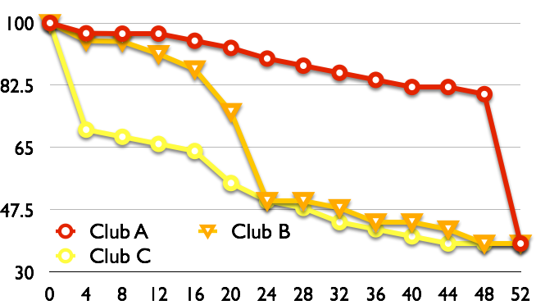
Example

Slide 7
Quantitative Research
342,759members
4 years
5 Sectors
Industry Representative Sample

Slide 8
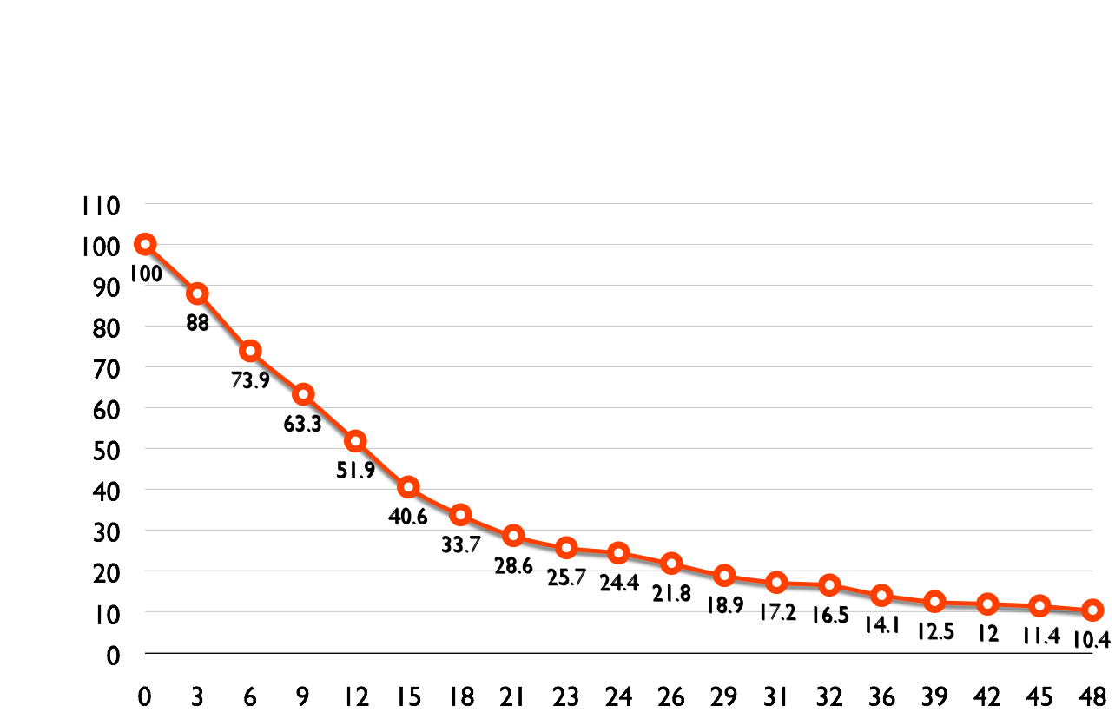
UK example results
(342,759 members)
52%
24%
14%
10%
36 Operators - 100 Clubs

Slide 9
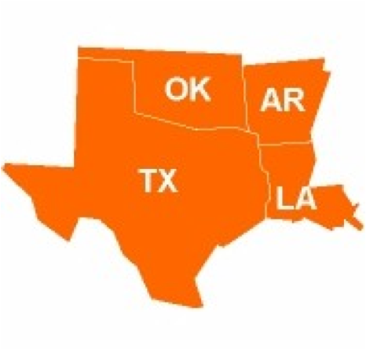
US pilot results (CSW)
N=181,227
97 Clubs

Slide 10
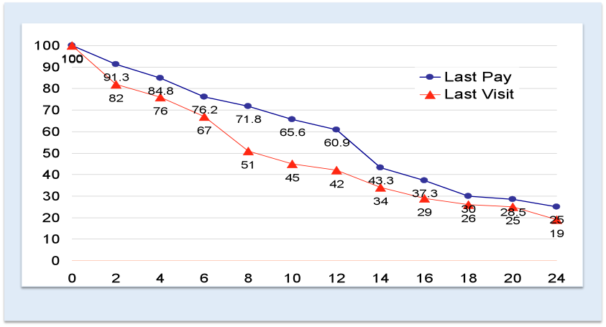

Slide 11
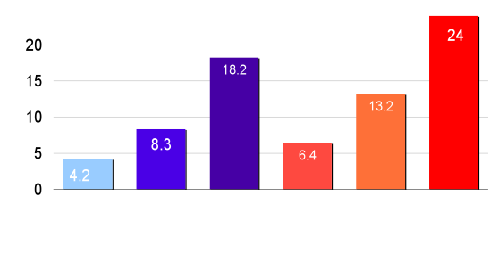
Usage - Payments
25th
50th
75th
25th
50th
75th
Visits
Payments

Slide 12
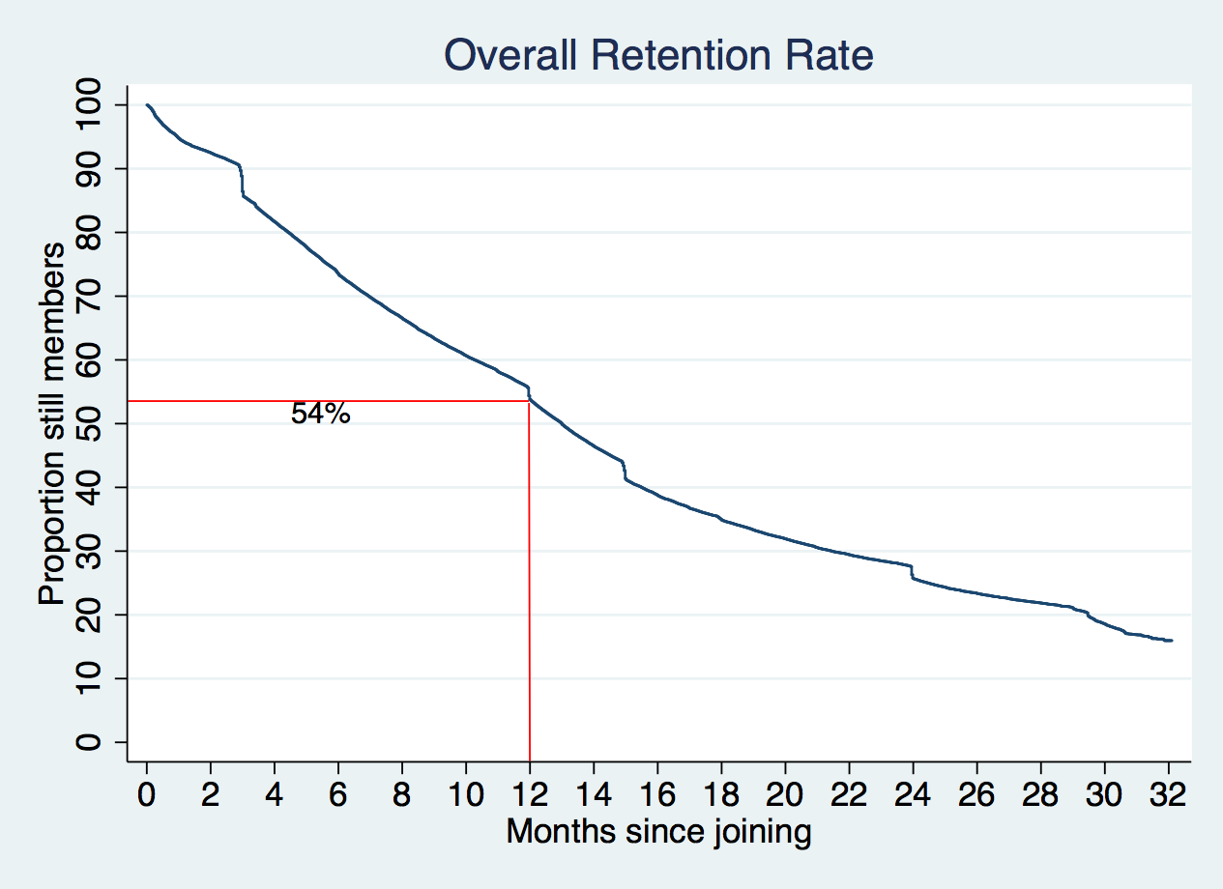
Average length of membership = 13 months

Slide 13
Average length of membership in months

Slide 14
Attrition rate (cancellations per 1,000 members per month)
Overall rate 53.9/1,000/month
37+ members month

Slide 15
Average income per month based on 1,000 members paying $50 per month during the first 12 months of membership
Total 12 month income
Portland = $412, 910
New York = $445, 865
8% gap was worth $32,955
New York
5000= $164,775

Slide 16
1,000,000 Member
North American Retention Study
2015

Slide 17
Un modifiable variables
Age Gender
Location Sector

Slide 18
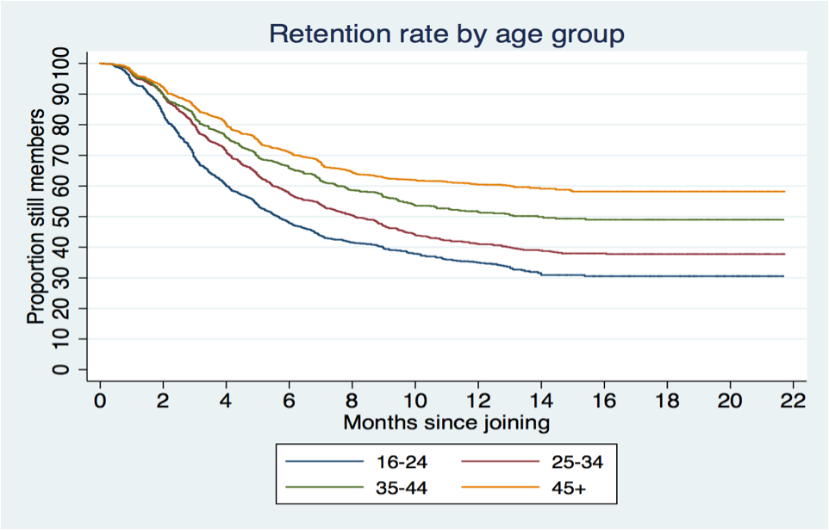

Slide 19
Modifiable
Inductions,
Interaction
Visit frequency
Contracts
Pricing policy

Slide 20
4 Visit Rule
Making at least 4 visits per month reduces the risk of membership cancellation by
29%.

Slide 21
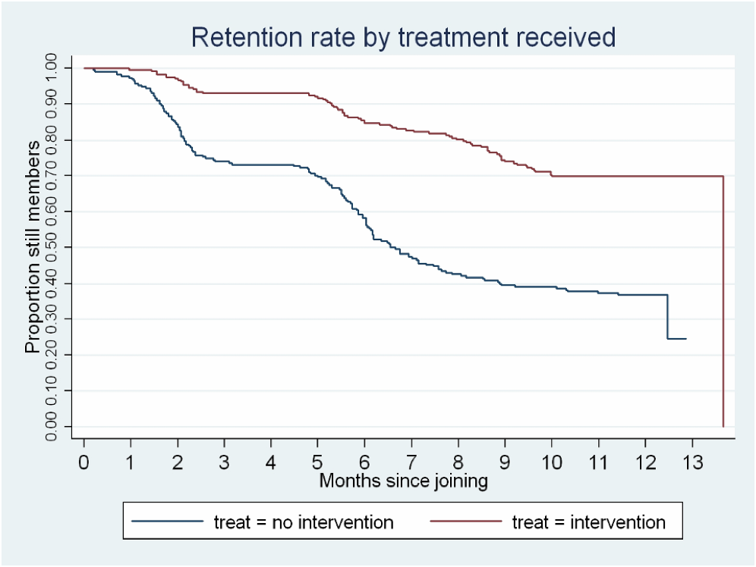
7 months extra
60 +30
+20 +10 min
60 min

Slide 22
Interaction effect
1 Interaction | 2-3 Interactions | 4+ Interactions
20% more likely to visit | 50% more likely to visit | 80% more likely to visit
The probability of making a visit next month if fitness staff talk to you during a visit this month.
Notes:
Using a statistical method called odds ratio’s it is possible to calculate the likelihood of an event happening. Where one interaction took place members were 20% more likely to visits in the following month. So if i speak to you once in February you are 20% more likely to visit in March. Etc, etc.

Slide 24
Compound effect
If all members
had a personal programme,
had at least one follow up appointment,
are spoken to each visit,
have used their club in the last 2 weeks
are confident of retaining their membership at months
57% of cancellations would have been avoided.

Slide 26
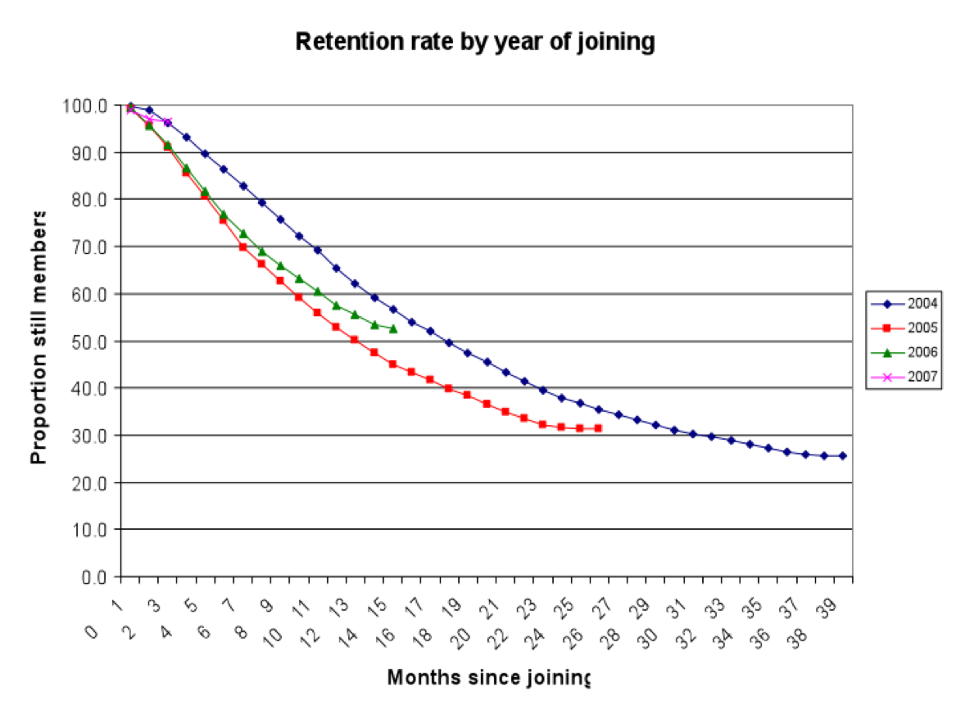
SERCO

Slide 27
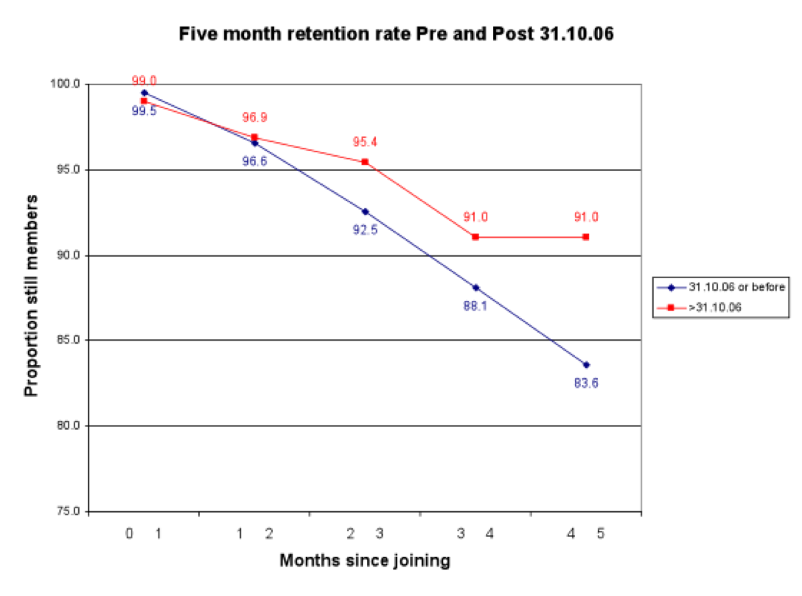
SERCO
This gap was worth
80K per month

Slide 29
+ £11,500,000

Slide 30
Limited by the data collected for other variables

Slide 31
Better data means
Correlation to
Causation

Slide 32
Better data means
Reactive to
Predictive

